Slide 1
Java Exceptions
Università di Modena e Reggio Emilia
Prof. Nicola Bicocchi (nicola.bicocchi@unimore.it)

Slide 2
The world without exceptions
If an error happens inside a method developers might be tempted to:
return a special value
interrupt the execution
List<Integer> list = new ArrayList<Integer>();
public int getItem(int i) {
if (list.size() <= i) {
return -1;
return list.get(i)
}
Developers must remember value/meaning of return values
List<Integer> list = new ArrayList<Integer>();
public int getItem(int i) {
if (list.size() <= i) {
System.exit();
return list.get(i)
}
Resulting code not reusable!
Never do this!

Slide 3
Real-world problems
Terminating execution inside a method must be avoided. The resulting code is not reusable
The use of return codes implies:
Code is messy to write and hard to read
Only the direct caller can intercept errors (no delegation to any upward method)
retval = function();
if (retval == ERROR_CODE_1) {
// handle error 1
} else if (retval == ERROR_CODE_2) {
// handle error 2
} …

Slide 4
An example, read a file into memory
Open a file
Determine file size
Allocate the needed memory
Read the file into memory
Close the file
All these operations can fail!
Errors must be checked.

Slide 5
First approach
Short, readable BUT not reusable nor dependable (errors are not checked at all)
void loadFile() {
open file;
determine file size;
allocate memory;
read file into memory;
close file;
}

Slide 6
Second approach
open file;
if(operationFailed)
return -1;
determine file size;
if(operationFailed)
return -2;
allocate memory;
if(operationFailed) {
close the file;
return -3;
}
read file into memory;
if (operationFailed) {
close the file;
return -4;
}
close file;
if (operationFailed)
return -5;
return 0;
Reusable, dependable BUT long and obscure
A lot of error-detection and error-handling code
To detect errors we have to remember the specification of library calls
Each library has its own standards

Slide 7
Third approach (Exceptions)
try {
open file;
determine file size;
allocate memory;
read file into memory;
close file;
} catch (fileOpenFailed) {
doSomething;
} catch(determineSizeFailed) {
doSomething;
} catch (memoryAllocationFailed) {
doSomething;
} catch (readFailed) {
doSomething;
} catch (fileCloseFailed) {
doSomething;
}

Slide 8
Exceptions and Errors
Trowable
Error
Checked
Exception
RuntimeException
Uncheked
Unchecked

Slide 9
Errors
An Error is a subclass of Throwable referring to serious issues that a reasonable application should not try to catch. Most of errors are truly abnormal conditions.
LinkageError indicates that a class has some dependency on another class; however, the latter class has incompatibly changed after the compilation of the former class.
VirtualMachineError indicates that the Java Virtual Machine is broken or has run out of resources
Trowable
Error
Checked
Exception
RuntimeException
Uncheked
Unchecked

Slide 10
Checked and Unchecked Exceptions
Checked exceptions
Exceptions managed with try/catch and checked by the compiler
Examples: IOException, SQLException, ClassNotFoundException, …
Unchecked exceptions
Their generation is not foreseen (can happen everywhere). Do not need to be managed with try/catch (not checked by the compiler).
Their management would make the code excessively complicated (try/catch everywhere)
Examples: NullPointerException, ArrayIndexOutOfBound, …
Trowable
Error
Checked
Exception
RuntimeException
Uncheked
Unchecked

Slide 11
Basic concepts (stack trace)
public class App {
public void f(int i) {
g(i);
}
public void g(int i) {
new ArrayList().get(i);
}
public static void main(String[] args) {
new App().f(5);
}
}
Exception in thread "main" java.lang.IndexOutOfBoundsException: Index: 5, Size: 0
at java.util.ArrayList.rangeCheck(ArrayList.java:657)
at java.util.ArrayList.get(ArrayList.java:433)
at App.g(App.java:9)
at App.f(App.java:6)
at App.main(App.java:12)

Slide 12
Basic concepts (delegation)
The code causing an error generates an exception
At some point, up in the hierarchy of method invocations, a method might catch and handle the exception
All methods can
Intercept the exception (no delegation)
Ignore the exception (complete delegation)
Intercept and generate a new exception (partial delegation)

Slide 13
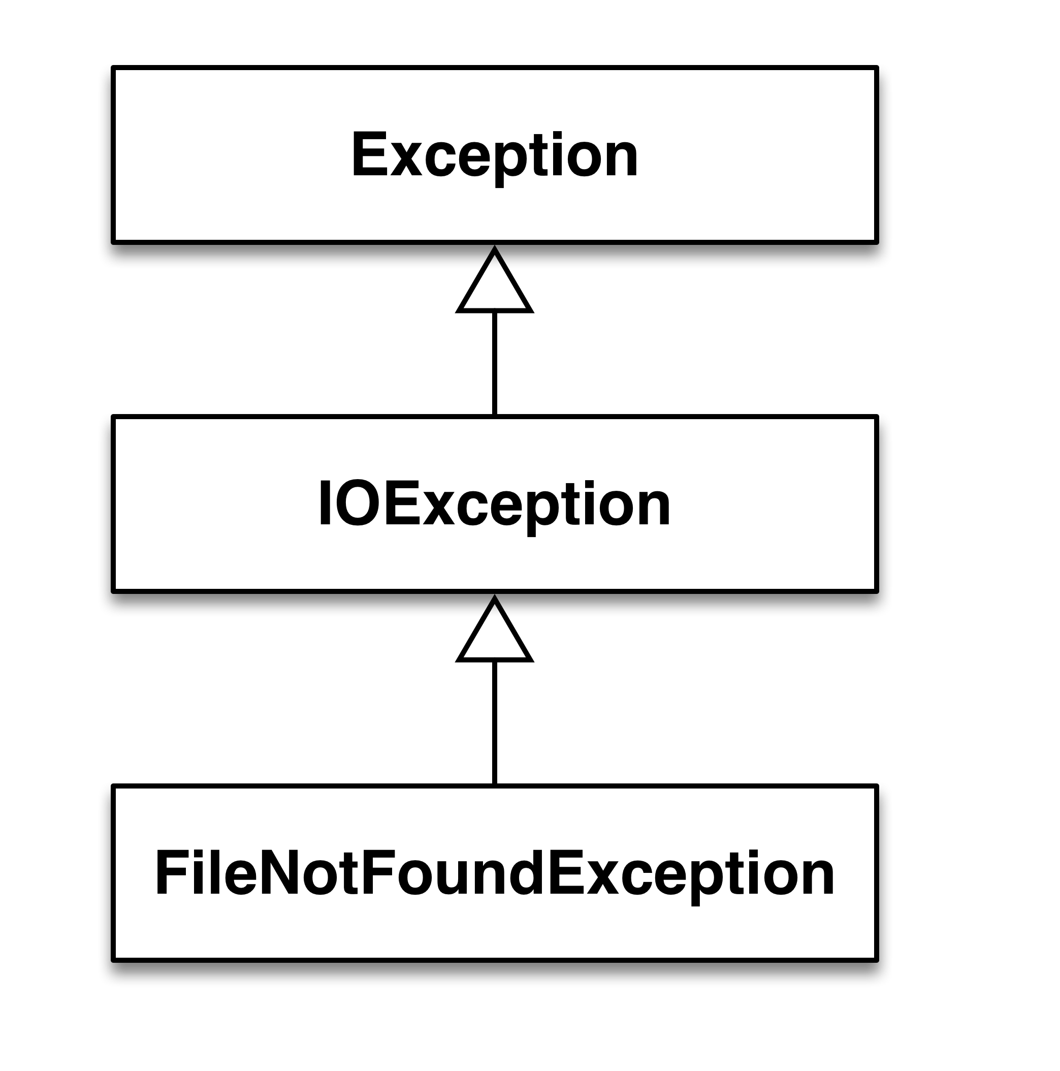
Interception (no delegation)
public static void main(String[] args) {
char[] v = new char[256];
try {
FileReader f = new FileReader("test.txt");
} catch (FileNotFoundException e) {
e.printStackTrace();
}
}

Slide 14
Interception (no delegation)
public static void main(String[] args) {
char[] v = new char[256];
try {
FileReader f = new FileReader("test.txt");
f.read(v);
f.close();
} catch (FileNotFoundException e) {
e.printStackTrace();
} catch (IOException e) {
e.printStackTrace();
}
}

Slide 15
Interception (no delegation)
public static void main(String[] args) {
char[] v = new char[256];
try {
FileReader f = new FileReader("test.txt");
f.read(v);
f.close();
} catch (IOException e) {
e.printStackTrace();
}
}

Slide 16
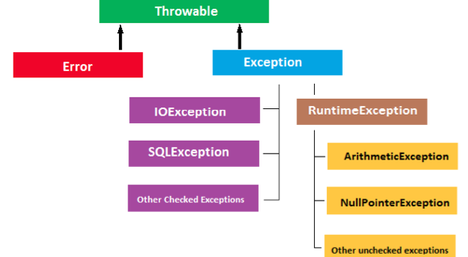
Matching Rules
More
general
More
specific

Slide 17
Complete delegation
For enabling delegation, methods must declare exception type(s) generated within their implementation using the keyword throws (only for checked exceptions, see later)
Exceptions can be either generated:
by the method itself
by other methods called within the method and not caught
public static void main(String[] args)
throws IOException {
char[] v = new char[256];
FileReader f = new FileReader("test.txt");
f.read(v);
f.close();
}

Slide 18
Complete delegation
/* foo() delegates IOException */
class Dummy {
public void foo() throws IOException {
char[] v = new char[256];
FileReader f = new FileReader("test.txt");
f.read(v);
f.close();
}
}
/* main() intercepts IOException */
class App {
public static void main (String args[]) {
try {
new Dummy().foo();
} catch (IOException e) { /* do something */ }
}
}

Slide 19
Complete delegation
class Dummy {
public void foo() throws IOException {
char[] v = new char[256];
FileReader f = new FileReader("test.txt");
f.read(v);
f.close();
}
}
/* main() intercepts IOException and differentiate among subclasses */
/* more specific subclasses first! */
class App {
public static void main (String args[]) {
try {
new Dummy().foo();
} catch (FileNotFoundException e) {
System.out.println("FileNotFoundException");
} catch (IOException e) {
System.out.println("IOException");
}
}
}

Slide 20
Complete delegation
Class Dummy {
public void foo() throws IOException {
char[] v = new char[256];
FileReader f = new FileReader("test.txt");
f.read(v);
f.close();
}
}
/* main() delegates IOException as well */
Class App {
public static void main (String args[]) throws IOException {
new Dummy().foo();
}
}

Slide 21
Generation (throw)
(Eventually) Declare a user defined Exception subclass
Throw upward a new exception object from a method marked with the throws keyword

Slide 22
Generation (throw)
public class App {
public static void main(String[] args) {
ArrayList<String> l = new ArrayList<String>();
l.get(0);
}
}
Exception in thread "main" java.lang.IndexOutOfBoundsException: Index: 0, Size: 0
at java.util.ArrayList.rangeCheck(ArrayList.java:657)
at java.util.ArrayList.get(ArrayList.java:433)
at App.main(App.java:12)

Slide 23
Generation (throw)
public class ArrayList<E> extends AbstractList<E> {
…
public E get(int index) {
rangeCheck(index);
return elementData(index);
}
private void rangeCheck(int index) {
if (index >= size) throw new IndexOutOfBoundsException(outOfBoundsMsg(index));
}
…
}

Slide 24
Partial delegation
Methods can intercept and exception, handle it partially, and throw a new exception to be managed by callers.
The new thrown exception can be either:
of the the same type (of the intercepted exception)
of a different type (of the intercepted exception)

Slide 25
Partial delegation (same exception)
public static void main(String[] args)
throws IOException {
char[] v = new char[256];
FileReader f;
try {
f = new FileReader("test.txt");
f.read(v);
f.close();
} catch (IOException e) {
// do something
throw (new IOException());
}
}

Slide 26
Partial delegation (custom exception)
It is possible to define new types of exceptions if the ones provided by the system are not enough
Developers have to define a new subclass of Exception
public class MyException extends Exception {}
In most cases, there is no need of writing addition code
To make subclasses completely compatible with java.lang.Exception, the Exception constructors must be explicitly written. Otherwise, only the default constructor will be available in subclasses.

Slide 27
Partial delegation (custom exception)
public class MyException extends Exception {}
public static void main(String[] args)
throws MyException {
char[] v = new char[256];
FileReader f;
try {
f = new FileReader("test.txt");
f.read(v);
f.close();
} catch (IOException e) {
// do something
throw (new MyException());
}
}

Slide 28
Partial delegation (standard exception)
public static void main(String[] args) {
char[] v = new char[256];
FileReader f;
try {
f = new FileReader("test.txt");
f.read(v);
f.close();
} catch (IOException e) {
// do something
throw (new RuntimeException());
}
}
RuntimeException is unchecked. It is frequently used for notifying the upper layers about errors that cannot be recovered. Unchecked exceptions do not required the throws mark on the method declaration

Slide 29
Nested exceptions
public static void main(String[] args) {
char[] v = new char[256];
FileReader f = null;
try {
f = new FileReader("test.txt");
f.read(v);
f.close();
} catch (IOException e) {
FileWriter fw = null;
try {
fw = new FileWriter("log");
fw.write("Error in opening test.txt");
fw.close();
} catch (IOException e1) {
/* the operation has failed, writing the log has failed
* nothing can be done anymore */
throw new RuntimeException();
}
}
}

Slide 30
Finally
The JVM always executes the finally block regardless the outcome of try/catch. It is used for cleaning things up (e.g., closing files, database connections, etc)
Errors inside the finally block, usually cannot be recovered. It makes sense to use RuntimeException() (unchecked)
public static void main(String[] args) {
char[] v = new char[256];
FileReader f = null;
try {
f = new FileReader("test.txt");
f.read(v);
f.close();
} catch (IOException e) {
// do something
} finally {
try {
if (f != null) f.close();
} catch (IOException e) {
throw new RuntimeException();
}
}
}

Slide 31
Exceptions and loops
For errors affecting a single iteration (or items of a collection!), the try-catch blocks is nested in the loop. In case of exception the execution goes to the catch block and then proceed with the next iteration.
while(something){
try{
// potential exceptions
} catch(Exception e){
// discard iteration
}
}

Slide 32
Exceptions and loops
For errors compromising the whole loop, the loop is nested within the try block. In case of exception the execution goes to the catch block, thus exiting the loop.
try{
while(something){
// potential exceptions
}
} catch(Exception e){
// discard whole loop
}

Slide 33
Try with Resources
Support for try-with-resources (introduced in Java 7) allows us to declare resources to be used in a try block with the assurance that the resources will be closed when after the execution of that block.
The resources declared must implement the AutoCloseable interface.

Slide 34
Try with Resources
Scanner scanner = null;
try {
scanner = new Scanner(new File("test.txt"));
while (scanner.hasNext()) {
System.out.println(scanner.nextLine());
}
} catch (FileNotFoundException e) {
e.printStackTrace();
} finally {
if (scanner != null) {
scanner.close();
}
}

Slide 35
Try with Resources
try (Scanner scanner = new Scanner(new File("test.txt"))) {
while (scanner.hasNext()) {
System.out.println(scanner.nextLine());
}
} catch (FileNotFoundException fnfe) {
fnfe.printStackTrace();
}

Slide 36
Using Multiple Resources
Multiple resources can be declared just fine in a try-with-resources block by separating them with a semicolon
try (Scanner scanner = new Scanner(new File("testRead.txt"));
PrintWriter writer = new PrintWriter(new File("testWrite.txt"))) {
while (scanner.hasNext()) {
writer.print(scanner.nextLine());
}
}

Slide 37
Summary
Java provides four keywords related to exceptions
Try
Contains code that may generate exceptions
Catch
Defines the error handler
Finally
Code block being executed regardless the catching phase
Throws
Mark a method as able to delegate exceptions
Throw
Generates a new exception
There is also a class for representing exceptions
java.lang.Exception

Slide 38
Summary
Exceptions separate error handling from functional code
Functional code is compact, readable and well-separated from error handling code
Exceptions allows delegate error handling to higher levels
Callee might not know how to recover from an error
Moving upwards along the stack trace implies a larger “field of view”
Caller of a method can handle error in a more appropriate way than the callee

Slide 39
Exceptions - Best Practices

Slide 40
Preserve encapsulation
Never let implementation-specific checked exceptions rise to the higher layers. For example, do not propagate SQLException from data access code to the business objects layer. Business objects layer do not need to know about SQLException. You have two options:·
Convert SQLException into another checked exception, if the client code is expected to recover from the exception.
Convert SQLException into an unchecked exception, if the client code cannot do anything about it.

Slide 41
Close or release resource in finally block
Closing resources in finally block guarantees that precious and scarce resource are released properly both in case of normal and aborted execution.
From Java 7, language has a more interesting automatic resource management or ARM blocks, which can do this for you.

Slide 42
Provide meaningful message on Exception
The message of Exception is the most important place where you can point out the cause of a problem because it is the first place programmers looks upon.
Always try to provide precise and factual information here. For example, compare:
new IllegalArgumentException("Incorrect argument for method”);
new IllegalArgumentException("Illegal value for ${argument}: ${value}”);
The first one just says that argument is illegal or incorrect, but second one include both name of argument and its illegal value which is important to point out cause of error.
Always follow this Java best practice, when writing code for handling exceptions and errors in Java.

Slide 43
Convert Checked Exception into RuntimeException
This is one of the technique used to limit use of checked Exception in many of frameworks like Spring ,where most of checked Exception, which are raised from JDBC is wrapped into DataAccessException, an unchecked Exception.
This Java best practice provides benefits, in terms of restricting specific exception into specific modules, like SQLException into DAO layer and throwing meaningful RuntimeException to client layer.

Slide 44
Avoid empty catch blocks
Nothing is worse than empty catch block, because it not just hides the Errors and Exception, but also may leave your object in unusable or corrupt state.
Empty catch block only make sense, if you absolutely sure that Exception is not going to affect object state on any ways, but still its better to log any error comes during program execution.

Slide 45
Use Standard Exceptions
Using standard Exception instead of creating own Exception is better in terms of maintenance and consistency.
Reusing standard exception makes code more readable, because most of Java developers are familiar with standard RuntimeException from JDK like, IllegalStateException, IllegalArgumentException etc. and they will immediately be able to know purpose of Exception, instead of looking out another place on code or docs to find out purpose of user defined Exceptions.

Slide 46
Document Exception thrown by any method
Java provides throw and throws keyword to throw exception and in javadoc you have @throw to document possible Exception thrown by any method. This becomes increasingly important if you are writing API or public interface. With proper documentation of Exception thrown by any method you can potentially alert anyone who is using it.

